Slide 1
OJS 3 Webinar:
Overview of features and upgrade plans
Kristi Park
Director, TDL
kristi.park@austin.utexas.edu
TDL Helpdesk: support@tdl.org
Notes:
Welcome everyone – this is Kristi Park. We’ll get started in just a moment, but I’m going to begin recording our webinar now. Please stand by.
*****
Good morning and welcome to this TDL webinar on Open Journal Systems version 3, during which we’ll provide an overview of new features and plans for upgrades of TDL-hosted journals.
My name is Kristi Park. I’m the Director of the Texas Digital Library and also serve as the service manager for our OJS hosting service.
TDL is ready to begin upgrading our hosted journals to the latest version of Open Journal Systems – it’s been a long time coming, and I know many of you have been anxious for this to happen. We’re excited to get this process started and believe it will be a great improvement for many of our journal teams.
Before we start, I have a couple of house-keeping notes.
If you have questions at any time during the presentation today, please feel free to enter those into the chat pod on the left side of the Adobe Connect screen. I’ll answer those as I find an appropriate moment, and we’ll have a Q&A Session at the end for those I don’t get to. Lea DeForest, TDL’s Communications Strategist is monitoring the chat window and will help me catch all of those questions.
Additionally, we are recording this webinar and will post it on our youtube channel after it has been captioned. We’ll also share out the slides and notes with those who registered for the presentation.

Slide 2
Agenda
TDL and Open Journal Hosting Services
OJS 3: Overview of New Features
Upgrade Process for TDL-Hosted Journals
Resources
Questions
Notes:
We have a lot of ground to cover today, so I will start with a VERY brief overview of Texas Digital Library and our OJS hosting service, for those of you not familiar with us.
Then we will head into an overview of some – not ALL – of the new features coming with OJS version 3.
Next I’ll spend some time going over the upgrade process for TDL-hosted journals, so that you know what to expect.
And finally I’ll share some links to resources we have available for you to continue learning and exploring as you prepare for this upgrade.
We’ll hopefully have some time for Q&A at the end.

Slide 3
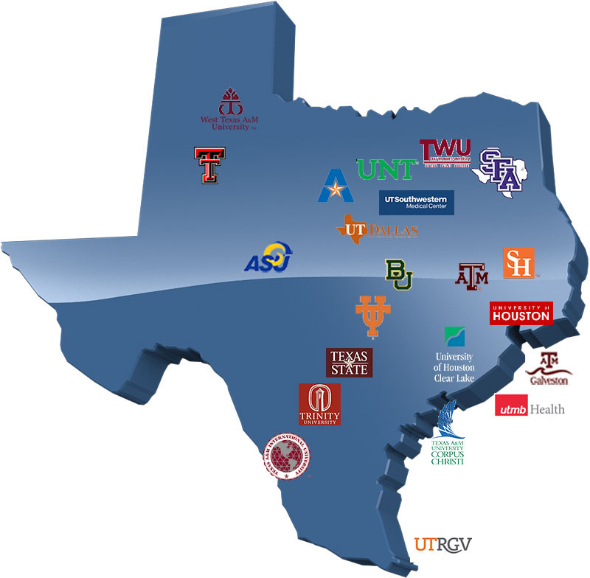
Texas Digital Library
The Texas Digital Library is a consortium of academic libraries that works together to support greater access to digital collections of enduring value.
Notes:
The Texas Digital Library is a consortium of higher education institutions that builds capacity for preserving, managing, and providing access to unique digital collections of enduring value.
As part of our mission to support research efforts at our member institutions, as well as increase access to the results of research, the TDL hosts academic journals using the Open Journal Systems platform. Thirteen of our 24 members currently use this service.

Slide 4
Open Journal Systems
Open source
Online
Open Access
Peer Review
Publication Management
Notes:
Open Journal Systems (OJS) is an open source solution to managing and publishing scholarly journals online.
It has been designed to reduce the time and energy devoted to the clerical and managerial tasks associated with editing a journal, while improving the record-keeping and efficiency of editorial processes.
OJS covers all aspects of online journal publishing, from establishing a journal website to operational tasks such as the author’s submission process, peer review, editing, publication, archiving, and indexing of the journal. OJS also helps to manage the people aspects of organizing a journal, including keeping track of the work of editors, reviewers, and authors, notifying readers, and assisting with the correspondence.
Many thousands of journals worldwide use the OJS platform.

Slide 5
Notes:
OJS is a product of the Public Knowledge Project: a non-profit research, education and software development project from Stanford and Simon Frasier Universities. PKP’s mission is to improve the quality of scholarly research and increase access to the published results of that research.
Our hosting service is, of course, deeply indebted to the work of the PKP community, as is this presentation, which relies heavily on the excellent and extensive documentation that the PKP community has created.

Slide 6
Editorial team
Institutional support
Your scholarly journal
Hosting and technical support
Notes:
Texas Digital Library hosts about 75 journals through partnerships with our member institutions. And it’s important to keep in mind that any successful hosted journal is a collaboration among multiple parties.
The Texas Digital Library provides hosting and technical support for the journal, while the journal’s editorial team undertakes the work of policy setting, workflow decision-making, and editorial workflow management.
Member institutions provide another important layer of support, serving as liaisons between the TDL and the editorial team and providing value-added services like consulting on scholarly communications issues.. If any journal teams on the line today don’t know who their journal liaison is, please get in touch with us at support@tdl.org and we’ll get you in contact!

Slide 7
First things first
OJS 3 is a major release, with some major changes.
TDL will upgrade journals in batches, by institution.
Starting with University of Houston and Texas State University
Next batch (October): Texas A&M Libraries
Goal: complete all upgrades by April
Multiple opportunities to test, learn, and theme your journal in OJS 3.
Flexible schedule – you tell us when you’re ready.
Notes:
Before we look at some of the new features in OJS 3, I want to lay some groundwork for these upgrades and what they entail.
OJS 3 is a major release, with some major changes to both the Reader and Administrative interfaces. It’ll take some getting used to but it’s a big improvement.
Because of major changes to the interface, any theming customizations you may have done to your OJS2 journal will not carry over to the upgrade site. This is something we’ll talk more about when we get into the upgrade process.
Secondly, TDL will upgrade journals in batches, by institution.
Starting with University of Houston and Texas State University
Next batch (October): Texas A&M Libraries
We’ll continue from there, hoping that we can accelerate the pace of upgrades as we go.
Goal: complete all upgrades by April. Hopefully we’ll be done well before then, but realistically we feel we need to spread these 75 journal site upgrades over several months to be able to adequately support each journal team, and allow our staff to maintain progress on other projects.
Each journal team will have multiple opportunities to test, learn, and theme their journal in OJS 3.
We will keep a flexible schedule – you will tell us when you’re ready to take the final step, because we want you and your journal to be well-prepared.

Slide 8
What’s New
Overview of OJS 3.x
Notes:
So let’s talk about what’s new.
As I mentioned, OJS 3 is significantly different than its predecessor.

Slide 9
Changes in OJS 3
Reader interface improvements
Editorial/Administrative interface changes
Fully responsive design
More easily customizable
Notes:
These include:
Reader interface improvements like
Easier navigation and
Simplified registration
Editorial/Administrative interface changes that increase efficiency and add new functionality.
It also includes a fully responsive design that in many ways is more easily customizable.

Slide 10
Reader Interface
Clean and functional
Notes:
We’ll go through some of these specific features now, starting with the reader interface.
By default, Open Journal Systems is installed with a very simple, functional user interface. This includes a top header, navigation bar, navigation blocks to the right, and a main content block in the middle of the page.

Slide 11
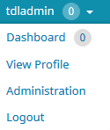
Reader Interface
User functions moved to top right of screen
Notes:
You can see from the screenshot that the user functions now exist as part of your profile menu at the top right of the screen – things like the Editoria Dashboard, profile info, etc. This takes the managerial content in OJS 3.x away from general user view.

Slide 12
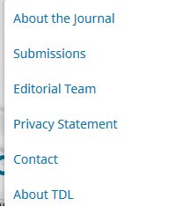
Reader Interface
Collapsible “about” menu
Notes:
Side bar information is clearly broken out, as well as your top navigation bar has collapsible menus for the “About” functions like policy statements, submission instructions, and contact info.
Any custom navigation links will be included in this collapsible menu as well.

Slide 13
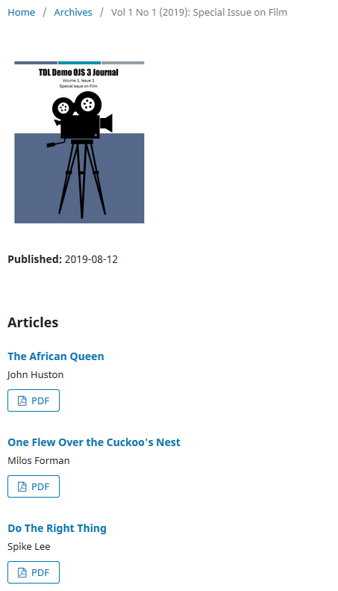
Reader Interface
Issue and Articles
Notes:
Here you can see an page with a journal issue.
Like OJS 2, each article has a linked title for viewing object metadata and abstracts, and galleys are now clearly labeled below the titles with clearer logos.

Slide 14
Simpler user registration
Notes:
To ease registration for new users, OJS 3 has prioritized a small set of required fields on a single screen (e.g., name, affiliation, email, etc.), and allow the registration to proceed once those few are completed.

Slide 15
Editorial Interface changes
The “Dashboard”
Notes:
We’ll move behind the scenes now to look at the Editorial Interface dashboard, which consists of the following elements:
Top Navigation Bar: To the left, you will find the name of the journal you are currently working with (e.g., OJS3 Demo Journal). Next to that are your Tasks (items needing immediate attention). To the right, you can switch languages if the journal is multilingual, view the reader interface, or click on your username to view your profile or logout.
Left Menu Panel: These are the major sections of the dashboard, including the submissions, issue management, settings, user and role management, and tools.

Slide 16
Dashboard
The left menu lists different sections of the administrative interface, depending on your permission level.
No more switching back and forth between “Journal Manager” user home and “Editor” user home.
Notes:
What appears here in the Left Menu panel is dependent on what permissions you have. Users with fewer permissions (e.g., Authors, Reviewers, Copyeditors, etc.) will see fewer links here.
This solves a common annoyance with OJS 2, which was the need to switch roles to do different tasks. Maybe you can relate to this: if you were a user enrolled as both a Journal Manager and an Editor, you had access to both the submissions as well as the journal settings. However, if you were in the middle of editing a submission, but realized you needed to tweak a setting on the web site, you needed to go to your user home page, select your role as Journal Manager, go to the Journal Manager home page, and then select the appropriate setting. In OJS 3, if you are logged in as a user with permission to access both the submissions and the journal settings, you no longer need to make that complicated switch. The settings are simply available in the left sidebar.

Slide 17
Dashboard
Hover over each menu item to expand sub-menus
Notes:
As you move over each menu item in the Left Menu Bar, submenus will expand.
I think you will find that most items are where you’d expect them to be, based on your experience of OJS 2.
But some things are moved around. There’s no “Journal Setup” section, for instance, like there is in OJS 2. Instead those settings are spread out throughout these other menu sections, and you may have to dig a bit for them.

Slide 18
Dashboard
Journal set-up and look-and-feel settings are all here under “Settings.”
Notes:
Many of those “Journal Setup” tasks are in the “Settings” Section of the Dashboard – this is where you set the journal name, ISBN number, etc (under Journal Settings) and where all the theming settings are (Under website settings).
If you are looking for plugins, the plugins are in this part of the interface as well.

Slide 19
Copyright and licensing
In addition to a Copyright notice, OJS 3 allows you to
communicate an Author Self-Archiving Policy, and…
Notes:
There are a number of things to explore in the journal settings, and I don’t have time to mention them all, but I do want to highlight some changes to the Copyright and licensing options.
Your Copyright Notice – which you had in OJS 2 – is now in a new section of Settings called “Distribution” settings.
But, In addition to allowing you to publish a Copyright notice, OJS 3 allows you to
communicate an Author Self-Archiving Policy,
designate the article’s copyright holder, and…

Slide 20
Copyright and licensing
In addition to a Copyright notice, OJS 3 allows you to
communicate an Author Self-Archiving Policy,
designate the article’s copyright holder, and
assign a Creative Commons license to published articles
Assign a CC license to published articles
Notes:
designate the article’s copyright holder (whether that is the author, the journal, or somebody else), and
assign a Creative Commons license to published articles

Slide 21
Copyright and licensing
Scroll down…
Notes:
You can see how this copyright information looks when attached to any published article in the journal by scrolling down to the bottom of the journal article landing page….

Slide 22
Copyright and licensing
Copyright and license info are attached to the article.
Notes:
Where you see the copyright notice and the CC license nicely displayed.

Slide 23
Editorial discussions
OJS 3 has a new internal discussion feature for each editorial stage (Submission, Review, Copyediting, Production).
Discussions work much like an online forum — a user creates a discussion topic, invites others to participate, and sends a message
Notes:
OK, now we’ll talk about some new features related to editorial workflow.
To help track the communications that are a critical part of a submission’s workflow, OJS 3 has a new internal discussion feature for each editorial stage (Submission, Review, Copyediting, Production). Discussions work much like an online forum — a user creates a discussion topic, invites others to participate, and sends a message (including with attachments).

Slide 24
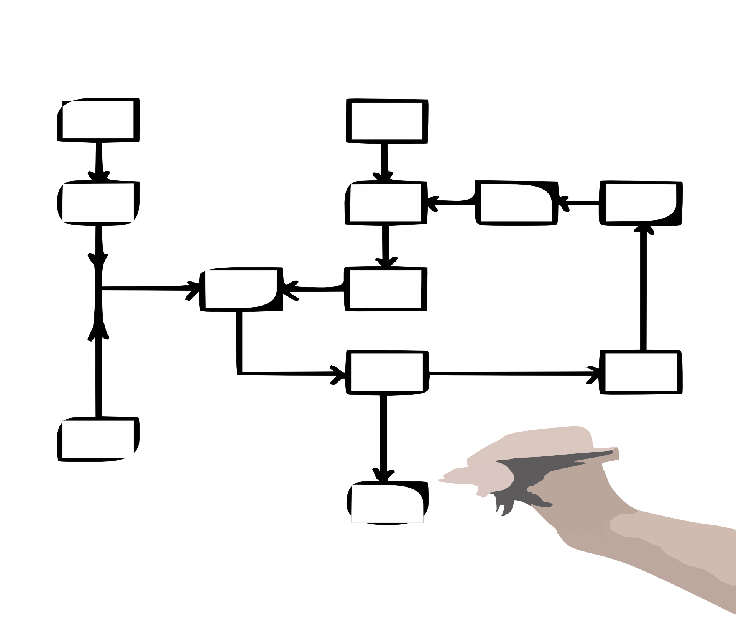
Flexible editorial workflow
Notes:
OJS 3 also provides more flexible workflow options.
The Editorial Workflow consists of 4 editorial stages: Submission, where new submissions are dealt with (rejected, assigned to section editors, etc.); Review, where peer review and author revisions take place; Copyediting, where the reviewed and revised files are sent for copyediting; and Production, where the final, copyedited version is converted into publishable formats (PDF, HTML, etc.), proofread, and scheduled for publication. This is a little different from OJS 2, which had copyediting, proofreading and galley creation all in the same step.
To increase editorial flexibility, you can easily move a submission from one stage to another without completing any of the possible tasks on that stage. From the submission stage, as you can see here, you can send this submission to Review, or you skip it entirely by accepting the submission and skipping review, or declining the submission.

Slide 25
Flexible editorial workflow
Notes:
This is true at every stage. Here in the copyediting stage, as you can see, you can skip it and send the submission directly to Production.

Slide 26
Flexible roles
Notes:
In addition to making the workflow more flexible, you can now easily change the names of existing roles.
This screen shot shoes the Users and Roles section of the Dashboard. It lists all the roles in the journal and lets you custmoize permission level for each role by checking or unchecking the boxes under different parts of the editorial process.
You can also change the names of these roles. If you’d rather have Production Managers rather than Journal Managers, you can simply rename that role by clicking “edit” under the role name.

Slide 27
Flexible roles
Notes:
Additionally, if you want to create a new role, you can do that too. OJS 3 let’s you make up any role you wish, and associate it with any (or all) stages of the workflow.

Slide 28
Default theme
Installed themes
Classic theme
Notes:
Your OJS 3 journal will come with two themes installed – the Default theme and the Classic Theme, shown here.
Default theme in OJS 3 allows you to quickly select alternative font combinations and header color choices, as well as upload a header logo or a homepage image. The same ability to create custom sidebar blocks, custom navigation links in the main nav, and issue cover art exists in OJS 3 that was in OJS 2.
Classic features a block-based layout for an issue’s table of contents, which makes great use of larger screens. But it also collapses into a clean, accessible view for smaller screens.
There’s additional documentation about these themes at the links on this slide.

Slide 29
Additional themes
Immersion theme is available and can be installed on request.
More about the Immersion theme at this link.
Notes:
Along with these preinstalled themes, additional OJS 3 themes exist, like this “Immersion” theme, which features a full-width header image. This theme is available in our Demo journal for testing and we can install it on request in your journal.

Slide 30
Theming
Easier CSS customization in OJS 3, if you want to.
Reminder: TDL does not provide CSS customization support.
If you had CSS customization in your OJS 2 journal, those customizations will not transfer in the upgrade.
Please note: If you had CSS customization in your OJS 2 journal, those customizations will not transfer in the upgrade.
Notes:
As before, experienced web developers may upload a stylesheet to further customize any of the themes provided.
In OJS 2, creating a new theme was often a challenge due to the extensive number of style sheets that needed to be modified. To reduce this burden, we have separated the style sheets and underlying templates for the administrative interface and the reader interface.
This brings two benefits: first, users who work with multiple OJS 3 journals (e.g., as an editor for one, an author for another, and reviewer for a third) will always have the same user experience in the administrative interface — it will always look the same on the inside; second, separating out the reader interface templates and style sheets means that they will be significantly smaller and easier to modify.

Slide 31
Theme reminders
If you had CSS customization in your OJS 2 journal, those customizations will not transfer in the upgrade.
Your logo, header image, and homepage image in your OJS 2 journal will not transfer over in the upgrade. These will have to re-uploaded or recreated.
PKP Theming Guide for OJS
Notes:
If you had CSS customization in your OJS 2 journal, those customizations will not transfer in the upgrade.
Your logo, header image, and homepage image in your OJS 2 journal will not transfer over in the upgrade. These will have to re-uploaded or recreated.
And remember, PKP has created excellent documentation about this application, including a great Theming guide for those interested in doing advanced theming for their journal.

Slide 32
OJS 3 is fully responsive
Notes:
Finally, in regards to web design, lack of responsiveness (the ability of the journal’s web page to adjust to the reader’s screen size) was a major issue for OJS 2

Slide 33
OJS 3 is fully responsive
Notes:
The OJS 3 reader interface is fully responsive and adjusts beautifully to different screen sizes, — whether you’re looking at it on a phone, a tablet, or a desktop computer.

Slide 34
Upgrade Process
What to expect as TDL upgrades its hosted journals to OJS 3
Notes:
So now that you know a little about what’s new and different in OJS 3, I’ll give a high level overview of our upgrade process and what you should expect.
As I’ve indicated, we will be upgrading 75 individual journals and want to be able to provide space and support for each journal team to get its journal prepared for this big change.
As a result we will be doing a staged process, working institution-by-institution, in collaboration with our library contacts.
When we begin the upgrade process for any given institution, I’ll send an email out to all journal teams and library contacts giving you a heads up that we’re about to begin.
After that we’ll begin working with each individual journal, and that’s the process I’m goig to talk about now.

Slide 35
Upgrade process
“Live” OJS 2 site will run in parallel with a “Stage” OJS 3 site until ready to switch.
When your journal team is ready, we will migrate the content from your legacy journal into the new site.
Notes:
This is a busy slide, and you don’t need to try to read everything that’s on here because I’m going to break it down on the next few slides..
The things to note here are that TDL will be creating new journal sites in OJS 3 in parallel to your OJS 2 site and migrating your legacy content into the new site. This means you will have a LEGACY (OJS 2) site - represented by the orange column) and a STAGING (OJS 3) site (the blue column) running in parallel until the end of the upgrade process.
The LEGACY site will remain your "live" or production OJS journal until we make the final URL switch at the end of the migration.

Slide 36
Upgrade process – step #1
Notes:
Now we’ll break it down.
As I said, Before we begin any institutional upgrade, we’ll send out a big email to all the journal teams from that institution giving you a heads up.
Soon after, each journal team will receive an invitation through our Helpdesk system to log into and explore your new OJS 3 journal.
That journal will have the same URL as your legacy journal, except with “-stage” added to the end.
The journal will be blank – no articles, issues, or users.
The Helpdesk ticket created with this invitation will follow the journal through the upgrade/migration process. If/when you have questions during the process, you can respond to that email.

Slide 37
Upgrade process – step #2
OJS 3 site
Notes:
As I said, the new OJS 3 site will have no content in it at this point.
You should use this time to develop the necessary theme elements for your new site – such as logo and homepage images, custom stylesheets, and color choices.
Take note of any theme changes you decide on and save all the images you create for the theme, because we won’t guarantee that some of that work won’t be lost once we migrate.
When your team is ready to proceed to the next step, you will reply to the Helpdesk ticket to request migration. Our system administrator will respond with a date on which he will do the migration.
To manage this process, and allow time for other projects he will be doing migrations on Tuesdays, Wednesdays, and Thursdays – so depending on traffic, it may be a couple of weeks down the road before he can fit you in.

Slide 38
Upgrade process - step #3
Notes:
On the scheduled date, Nick will migrate all the articles, issue data, users, etc. to the new journal site.
Once this process begins, your legacy OJS 2 site will become READ ONLY. Users will be able to come to the site and read articles, etc., but they won’t be able to submit mansucripts, do reviews, or perform editing tasks.
As a result, we will try to keep this period of the process as short as possible – hopefully 1 week or less.
Once the migration is complete, you’ll be notified and you should test the site thoroughly to make sure everything made it over and is working properly.
You can notify TDL of any issues you encounter via the Helpdesk ticket.
If there are no open issues after 1 week, we will switch the DNS so that your “real” URL points to the OJS 3 site, rather than the legacy site.
We will keep the legacy site around for a while, just in case, but it will no longer be the production site, and all new work should happen in the OJS 3 site at this point.

Slide 39
Reminders and things to consider
You will need to think about the “look” of your site. It won’t look the same in OJS 3, and you will be responsible for updating it prior to migration.
You have as much time as you need to plan for migration in your “–stage” journal. You will notify us when you’re ready for the migration stage.
When thinking about scheduling the migration,
remember that your site will be READ ONLY for some period of time. Take that into account and plan accordingly.
Set aside time during that week to test and implement any changes, so that the “read only” period is as brief as possible.
Notes:
So here are some things to consider as you get ready for this process:
Once again, you will need to think about the “look” of your site. It won’t look the same in OJS 3, and each journal team will be responsible for updating it prior to migration.
You have as much time as you need to plan for migration in your “–stage” journal. You will notify us when you’re ready for the final migration stage.
When thinking about scheduling the migration, keep two things in mind
First, remember that your site will be READ ONLY for some period of time. Take that into account and plan accordingly.
Second, Set aside time during that week to test and implement any changes, so that the “read only” period is as brief as possible.

Slide 40
TDL Resources
TDL Wiki
About OJS 3
Journal Upgrade Resources – includes testing guidelines, process workflows, etc.
Demo Site
TDL has a Demo OJS 3 site available at https://journals.tdl.org/ojs3-demo/index.php/ojs3-demo/index.
To get login credentials for this site, email the TDL Helpdesk at support@tdl.organd provide your name, institution, and email address.
The site is live only between 7:30am – 5:30pm.
Notes:
We are heading into the home stretch here, so please begin entering any questions you have into the chat window.
This slide includes links to TDL’s resources for you during this process.
In our wiki, we have a page with lots of information about OJS 3 and another with information about the upgrade process that I just shared with you. That Journal Upgrad Resources page also includes a testing checklist for your journal team to use to make sure everything is working properly post-migration.
This slide also includes links to a Demo OJS 3 site that we have available for you to explore in at any time.
You can email the TDL Helpdesk at support@tdl.org and provide your name, institution, and email address, and we’ll create a user for you with Journal Manager permissions.
This testing site is available during business hours, between 7:30am and 5:30pm on weekdays.

Slide 41
Additional Resources
OJS 3 Resources
What's New in OJS 3
OJS 3 New Features
Tutorials from PKP School (free with Wordpress login):
OJS 3: Setting up a Journal in OJS 3 (videos also available on YouTube)
OJS 3: Editorial Workflow in OJS 3 (videos also available on YouTube)
Becoming an Editor
Becoming a Reviewer
Writing for Publication
User guides and documentation:
Learning OJS 3.1: A Visual Guide to Open Journal Systems -- a concise textual guide with plenty of screenshots, covering OJS website set up and administration, editorial workflow management, and site statistics import & export
PKP documentation website -- an all-inclusive guide website for journal publishers and OJS system administrators, periodically updated by information professionals, latest updates including Crossref and DOIs Guide and EU General Data Protection Regulation Guide
PKP Community Forum - questions and troubleshooting forum for all OJS users, facilitating keyword searching across the site
GDPR Guide for OJS users
Notes:
There is also a wealth of information about the OJS 3 platform provided by PKP, and I encourage you to take advantage of these.
PKP has extensive documentation , as well as video tutorials and user guides, that can help you get up to speed with all the changes in OJS 3, or that you can refer to down the road.

Slide 42
TDL Helpdesk
support@tdl.org
http://www.tdl.org/support/helpdesk/
1-855-495-4317 (toll free)
Notes:
Finally, the TDL Helpdesk is available to you if and when you have questions. You can reach our support staff via email, web form, or at our toll free number. We staff the helpdesk during business hours.

Slide 43
Except where otherwise noted, this presentation is licensed under https://creativecommons.org/licenses/by/4.0/legalcode.
Please attribute to Texas Digital Library with a link to

Slide 44
Questions?
Kristi Park
Director, TDL
kristi.park@austin.utexas.edu
TDL Helpdesk: support@tdl.org

