Slide 1
VIREO
Submission, Management, and Publication
of Theses and Dissertations
KRISTI PARK, TEXAS DIGITAL LIBRARY
kristi.park@austin.utexas.edu | 512.495.4417
This presentation published under a Creative Commons Attribution-NonCommercial License

Slide 2
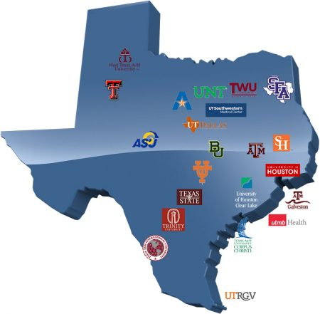
The Texas Digital Library consortium builds capacity for preserving, managing, and providing access to unique digital collections of enduring value.
Notes:
Texas Digital Library is a consortium of libraries that works together to support greater access to the riches of Texas academic institutions, and that mission includes providing access to THESES AND DISSERTATIONS.
We currently have 20 member institutions who utilize our suite of services that include hosted institutional repositories, online academic journal hosting, and ETD management, which is the focus of our presentation today.

Slide 3
Thesis & Dissertation publishing
Easy online submission for students
Workflow for managing approvals and publishing to repository
Flexible embargoes
Student maintains copyright
Local institutional control
Notes:
Vireo is a software application developed by the TDL (with enormous support from Texas A&M Libraries) that helps manage the entire workflow for electronic theses and dissertations (ETDs).
With Vireo, students submit their digital theses and dissertations via a simple online interface, while graduate offices can manage the ETD submission and approval process behind the scenes. Institutions can also use Vireo to publish the ETDs in their TDL Institutional Repositories, where they are readily available to other researchers. It has been in use, starting with Texas A&M, since 2009.

Slide 4
Vireo 4 coming soon...
Multiple submission workflows possible
Greater support for controlled vocabularies

Slide 5
Vireo @TDL
Notes:
The developed Vireo originally for its own member base and you can see here that 12 of our member institutions currently use Vireo to process and publish their ETDs. Most of these Vireo installations are hosted and managed by the TDL.
We’re also actively working with three other members to bring up hosted Vireo installations: UNT, UHCL, and UT Arlington.

Slide 6
Vireo Open-Source
and more…
Notes:
Along with the growing number of users within our own consortium, there are an increasing number of institutions nationwide that are deploying Vireo.
The TDL released Vireo under an open-source license in 2009, which means that we distribute the software code freely through a code repository under a license that allows anyone to download, modify, or distribute the software for free.
Since it went open-source, 10 institutions that we know of have deployed Vireo and several of them have made modifications or bug fixes in the code that they contribute back to the rest of the community of users.
Harvard University just recently announced its launch of Vireo during Open Access Week in October.
So in addition to developing and hosting Vireo, we are also now the stewards of an open-source software application with a growing and engaged group of library and graduate school users. And that user base includes not just the librarians and the thesis reviewers who use Vireo, but the system administers who download and run Vireo for their institutions and the software developers who might add a custom feature to Vireo or fix a bug that they find.

Slide 7
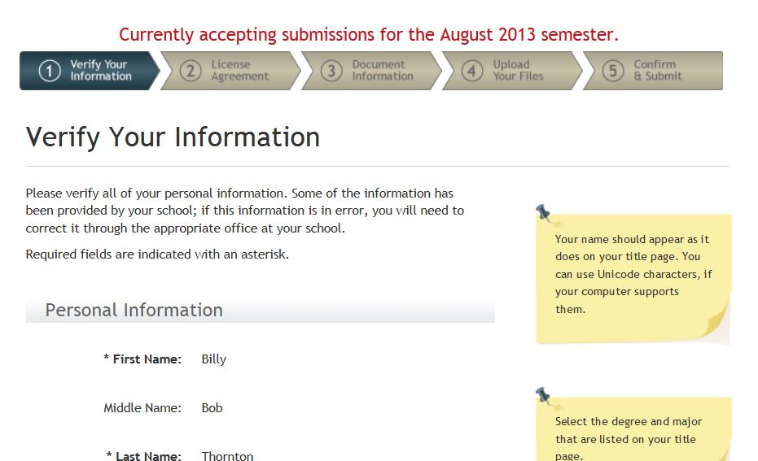
Vireo
Student submission interface
Notes:
Students submit their ETDs through a simple web interface, pictured here, and can select (with faculty approval) an embargo period for their thesis or dissertation. Available embargo periods can be customized by the graduate school.
In the customizable license included out-of-the-box with Vireo, students maintain copyright of their work and give TDL and their institution the limited right to publish and re-publish their work should format migration be necessary at a future date.

Slide 8
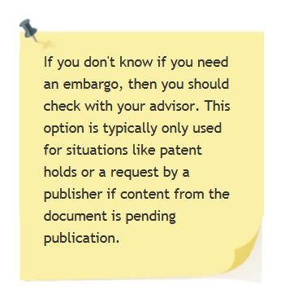
Vireo
Flexible embargo
options

Slide 9
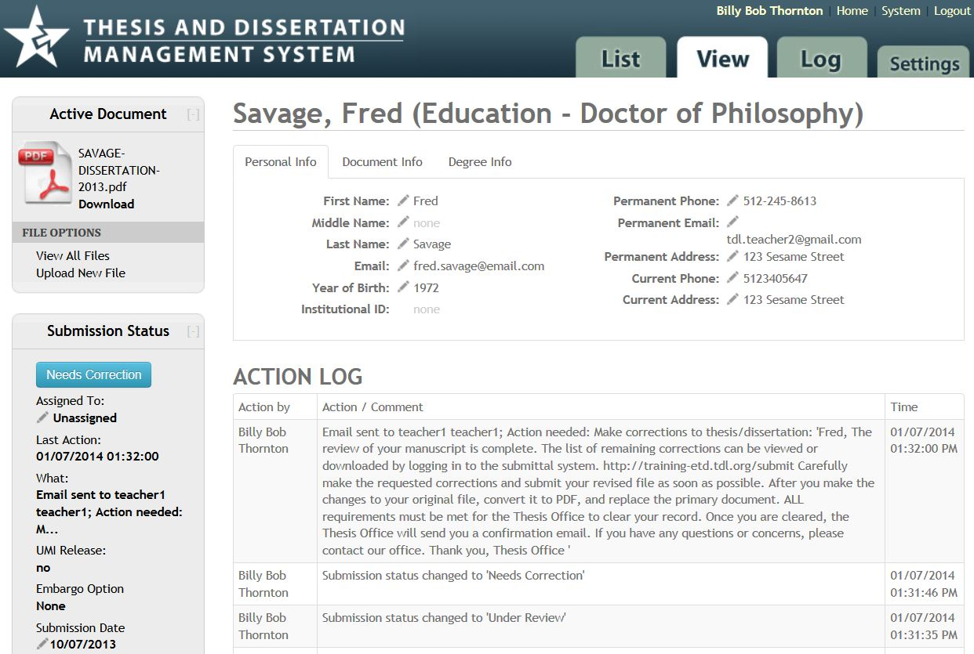
Vireo
Admin management
interface
Notes:
Vireo also includes a back-end management interface used by grad school and library staff to manage the approval and publication of the thesis or dissertation.
Vireo administrators can:
- Change the status of the ETD (from “in review” to “approved,” for instance)
- Review the document, embargo choices, etc.
- Communicate with student and faculty advisor
- Track external required actions (such as turning in forms)
- Publish the ETD to one or more institutional repositories

Slide 10
Vireo @TDL
Hosted and professionally managed installation of Vireo in the Amazon Cloud (currently Vireo 3)
Integration with local campus authentication (via Shibboleth)
All system administration tasks handled by TDL staff
On-going software development
Harvesting of ETD metadata into central TDL ETD Collection
Consultation on ETD program implementation
Coordination of Vireo Users Group
TDL Helpdesk Support for all Vireo users (students, staff, faculty)
Vireo training available

Slide 11
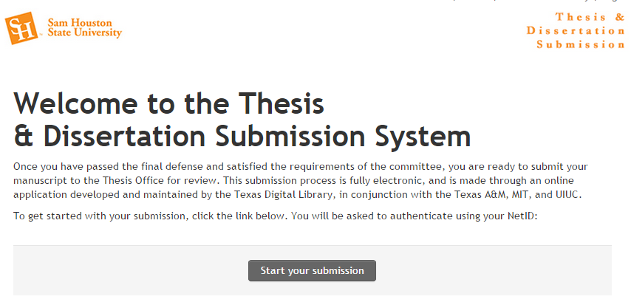
Demo
https://training-etd.tdl.org/

Slide 12
Implementation
First Steps
Policy & Workflow Planning
Communications planning
Testing & Implementation
(Contact support@tdl.org.)

Slide 13
Implementation
First Steps
Policy & Workflow Planning
Communications planning
Testing & Implementation
Gather campus stakeholders.
Gain understanding of Vireo functionality and customization options.
Subscribe to the Vireo Users Group email list. (Go to vireoetd.org for instructions.)
Understand requirements for integrating Vireo with Shibboleth authentication.
Review Vireo’s ETD metadata standard. (Currently undergoing revision by a TDL Working Group)
Determine overall timeline for pilot testing and full implementation, including communication timeline.
(Contact support@tdl.org.)

Slide 14
Implementation
First Steps
Policy & Workflow Planning
Communications planning
Testing & Implementation
Determine policies for:
Embargo types and durations
Metadata collection (what information do you want to collect from students?)
Email templates
Naming conventions for colleges, departments, etc.
Other needed configuration to Vireo settings
UMI/ProQuest workflow
Define workflows for grad school staff, repository manager(s), cataloger(s), faculty, and students.
Determine library workflows for cataloging ETD records and editing ETD metadata.
(Contact support@tdl.org.)

Slide 15
Implementation
First Steps
Policy & Workflow Planning
Communications planning
Testing & Implementation
Plan changes to graduate catalog and website, etc.
Plan communication with college and department staff regarding new policies and procedures.
Create or adapt instruction materials for students and faculty.
(Contact support@tdl.org.)

Slide 16
Implementation
First Steps
Policy & Workflow Planning
Communications planning
Testing & Implementation
Finalize Shibboleth integration with Vireo.
Implement Vireo settings, email templates, etc.
Undertake pilot testing of Vireo with limited group of students and faculty.
Launch new websites and other communications initiatives.
Provide ongoing training for all users.
Prepare for TDL harvesting of ETDs to federated repository.
Prepare for assessment of workflows and configuration after each semester.
(Contact support@tdl.org.)

Slide 17
Example Timeline for Implementation
Mid-Fall 2019
Spring 2020
Summer 2020+
Identification of stakeholders and project planning
Identification of pilot group
Vireo installation brought up by TDL and integrated with Shibboleth
Training of Vireo Administrator(s) (i.e., the person or group that makes Vireo-related policy decisions)
Configuration of Vireo
Training of Thesis Reviewers and library staff
Development of communication plans and materials for campus-wide implementation
Pilot testing with select student/faculty group
Pilot assessment and revision of workflows and configuration
Campus-wide implementation of Vireo for ETD submission
Assessment of implementation and revision of workflows and configuration (on-going)
(Can be condensed or expanded depending on circumstances.)

Slide 18
Vireo Users Group
Gathers and prioritizes user needs
Guides future software development
Facilitates information exchange among users
http://vireoetd.org
Notes:
Vireo Users Group has been around since 2010 as the body of users that guides development of Vireo and that works together to discuss best practices and use cases. As the use of the software has grown, this group has grown as well.

Slide 19
Vireo Resources
Vireo Users Group
http://www.vireoetd.org
Texas ETD Association
https://txetda.wordpress.com/
US ETD Association
http://www.usetda.org/
TDL Helpdesk
support@tdl.org
http://tdl.org/support/helpdesk
1-855-495-4317
https://training-etd.tdl.org/
Login: tdl.student1@gmail.com
Password: tdlstudent
(available M-F during business hours)

