Slide 1
Data Management For Researchers
Matthew McEniry, Associate Librarian, Director of Digital Scholarship Lab
matthew.mceniry@ttu.edu
May 24, 2023

Slide 2
Presentation Roadmap
Data Management
What is it?
Why do I care?
What does it look like in practice?
Data Management Plan
What is it?
What are the aspects of it?
How do I write it?
Dataverse & Dryad
What, Why, Who, When, How?

Slide 3
What is Data Management
A collection of tasks practiced throughout the lifecycle of research that make it easier to find, understand, navigate, and use your data.
Organization
Data Security
Data Documentation
Citations
Sharing & Publishing
Notes:
The more you do these tasks, the more they become habit and not chores!
Keeping your files organized (inside and out)
Backing up your data and keeping it secure
Documenting everything: data, code, variables, procedure
Citing your sources (including data)
Sharing and publishing the data behind your results

Slide 4
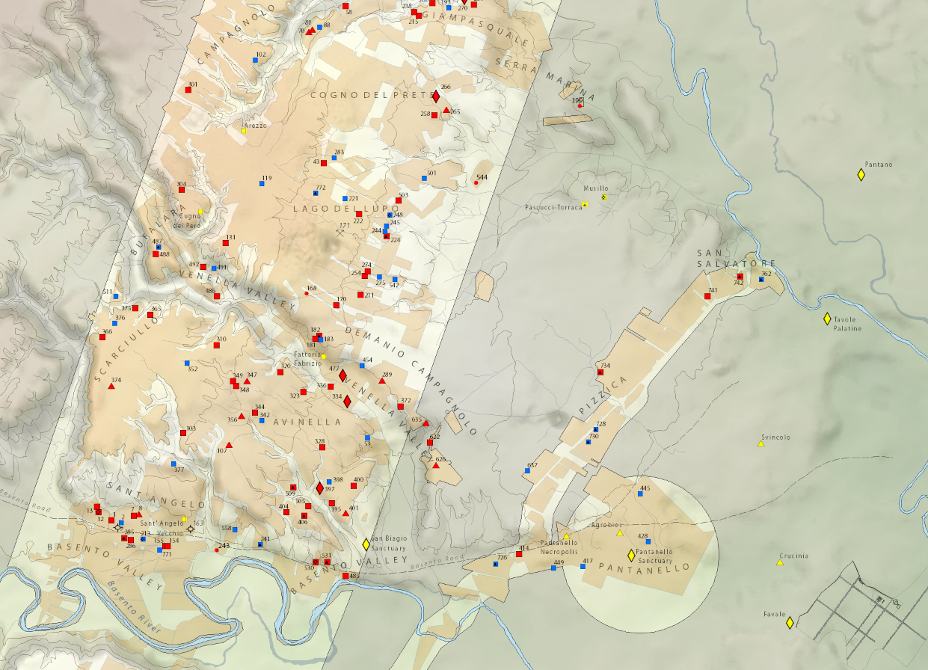
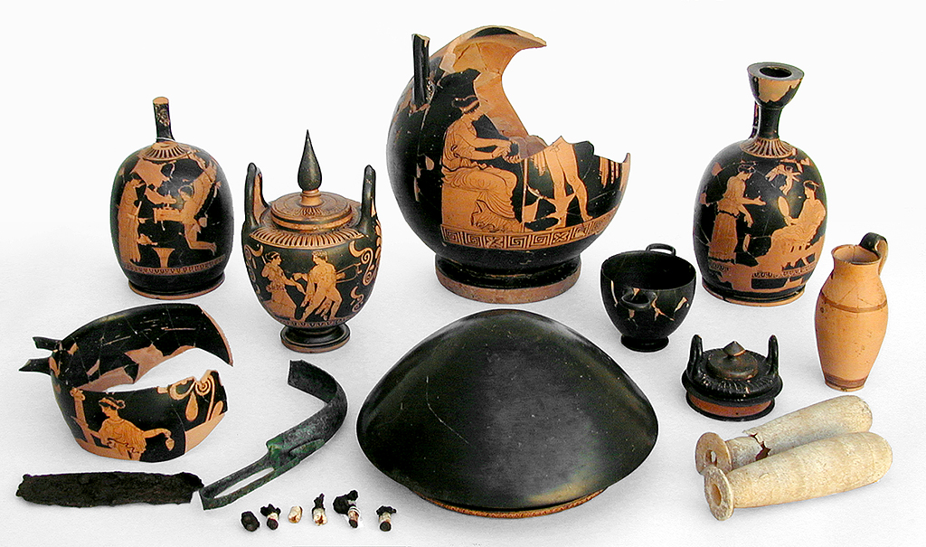
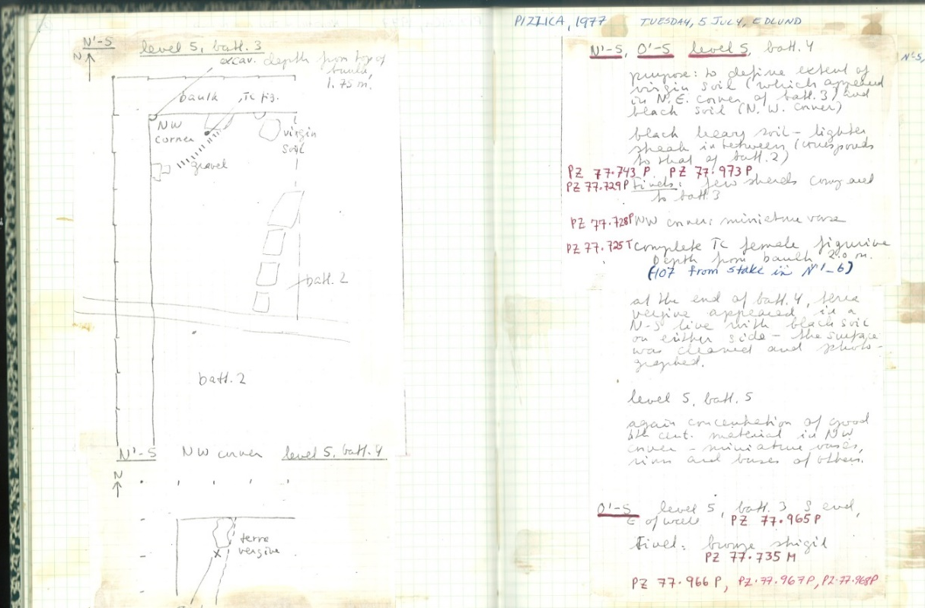
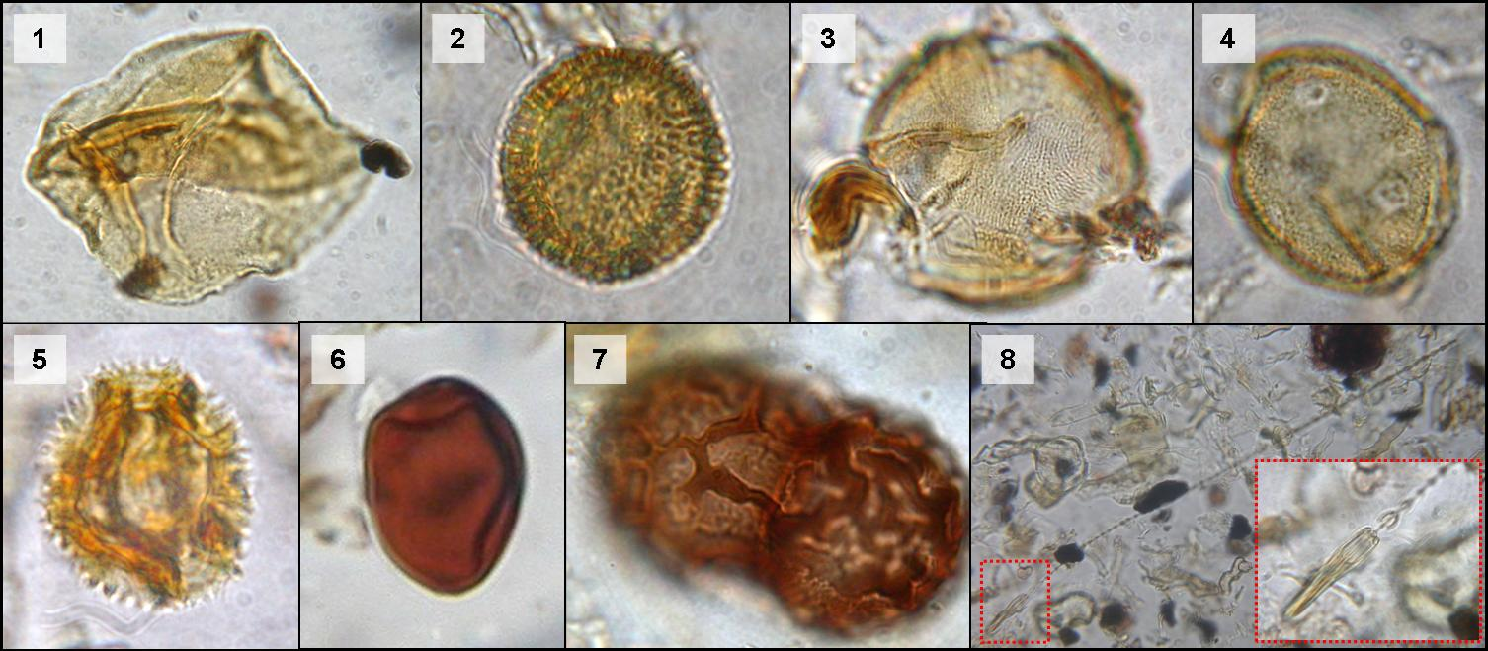
What are “data”?
Notes:
This is what they look like to me.

Slide 5
What are “data”?
Natural/Physical Sciences Social Sciences Humanities
Observational Qualitative Raw
Experimental Quantitative Interpretive/Derived
Simulation
Compiled

Slide 6
National Science Foundation
“…determined by the community of interest through the process of peer review and program management. This may include, but is not limited to: data, publications, samples, physical collections, software and models.”
From FAQs: https://www.nsf.gov/bfa/dias/policy/dmpfaqs.jsp#1
Notes:
This is how NSF defines it, in context of setting policy around what it means by data that you are required to plan for before asking for funds.
Again, context. Note physical collections.
Not so helpfully, they say it includes data.

Slide 7
National Endowment for the Humanities
“…materials generated or collected during the course of conducting research.”
Includes:
citations
software code
algorithms
digital tools
documentation
databases
geospatial coordinates
reports and articles
Excludes:
preliminary analyses
drafts of papers
plans for future research
peer review assessments
communications
confidential materials
information violating privacy
From: http://www.neh.gov/files/grants/data_management_plans_2016.pdf
Notes:
This is what NEH says (note code, reports, and documentation).

Slide 8
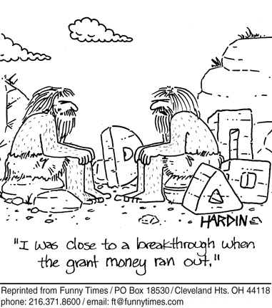
Why should I care?
Save time and money
Maximize your impact
Allow for data reuse
Do better research
Notes:
Carrots

Slide 9
Why else?
It’s required.
Notes:
Sticks.

Slide 10
OSTP Issues Guidance to Make Federal Funded Research Freely Available Without Delay
August 25, 2022 Press Release from the White House Office of Science and Technology Policy
Delivered guidance for agencies to update their public access policies as soon as possible to make publications and research funded by taxpayers publicly accessible, without an embargo or cost.
All agencies will fully implement updated policies, including ending the optional 12-month embargo, no later than December 31, 2025.
This policy guidance will end the current optional embargo period that allows scientific publishers to put taxpayer-funded research behind a subscription-based paywall.
Agencies will develop plans to improve transparency, including clearly disclosing authorship, funding, affiliations, and the development status of federally funded research
Agencies will work with OSTP to update their public access and data sharing plans by mid-2023.

Slide 11
Collecting Data
Test your plan
Automate where possible (but don’t rely on it solely)
Create snapshots
Ensure compliance
Office of Research Services
www.depts.ttu.edu/vpr/ors

Slide 12
Re-using data
Find the right data
Subject specialists: http://guides.library.ttu.edu/?b=s
Registry of Research Data Repositories: www.re3data.org
Integrate and tidy
Know your sources
Restrictions
Copyright
Data citation: datacite.org
Notes:
OpenRefine for clean up
R and the tidyverse?

Slide 13
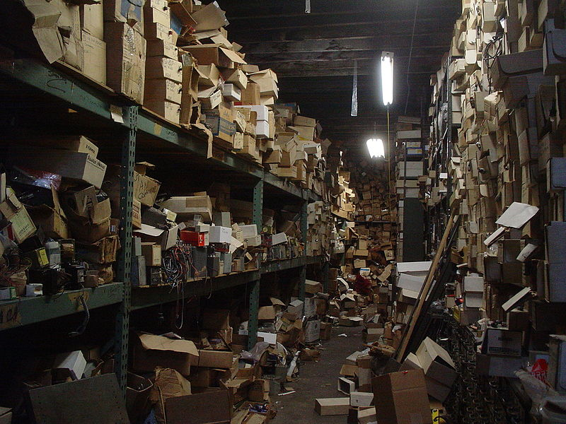
Organize
https://upload.wikimedia.org/wikipedia/commons/3/39/Messy_storage_room_with_boxes.jpg
Notes:
Pick a system that works for you!
Make it a habit.
Piling/tagging vs. nesting?
WRITE DOWN YOUR CONVENTION/explain your system.
Make a blank hierarchy, then fill it up

Slide 14
File Names
Be descriptive, not generic
Include dates
No funny characters
"/ \ : * ? " < > [ ] & $
Describe your convention
http://www.phdcomics.com/comics/archive.php?comicid=1323
Use a batch re-namer:
www.bulkrenameutility.co.uk (Windows)
www.renamer4mac.com (Mac)
www.powersurgepub.com/products/psrenamer.html (Linux, Mac, Windows)

Slide 15
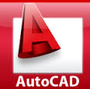
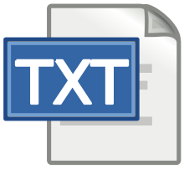
File Formats
Non-proprietary, open standards
Used commonly in your domain
Encoded with standard characters
Uncompressed (?)
Library of Congress:
www.loc.gov/preservation/resources/rfs

Slide 16
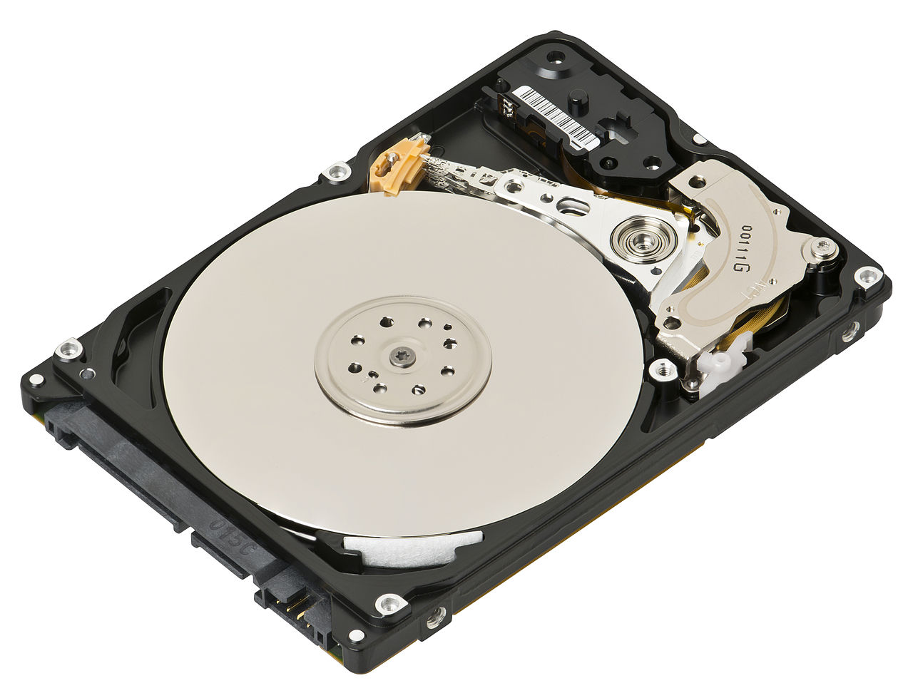
Storage options
Texas Tech University
TTU OneDrive (1 TB)
Department Specific Network Drives
TTU HPCC
TTU Dataverse Collection
TTU Dryad
Other Cloud
DropBox
Google Drive
iCloud
Box
Open Science Framework (5 GB free)
By Evan-Amos - Own work, CC BY-SA 3.0, https://commons.wikimedia.org/w/index.php?curid=27940250

Slide 17
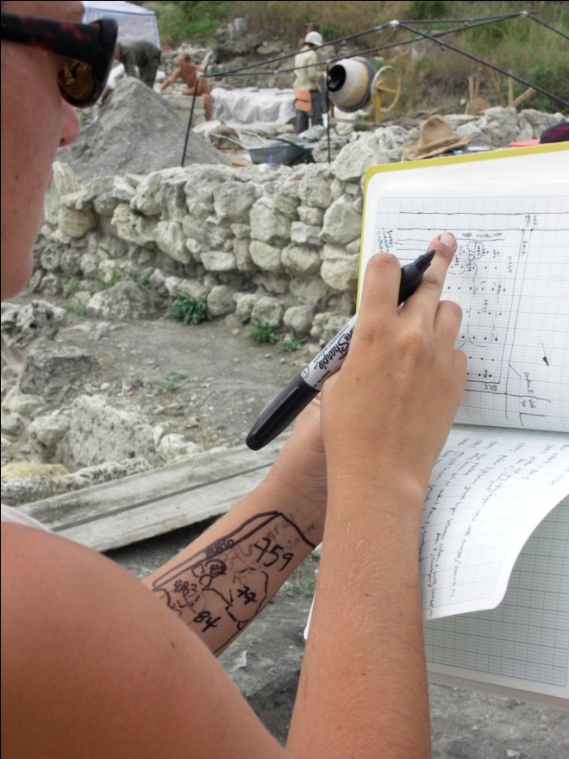
Document, Document, Document
Data only useful if understandable!
Data Documentation (Metadata)
Readme.txt (use a template)
Codebooks/lab books/field notes
Data Dictionaries
Electronic Lab Notebooks
Photo courtesy of Institute of Classical Archaeology
Notes:
Template provided by Research Data Services, University of Texas Libraries, UT Austin. Original template from Indiana University.
Don’t record metadata only on your arm!

Slide 18
Preservation and Access
Think Tech: an online publishing and archival service that scholars may use to distribute and archive their scholarly works with no limitations on content or format.
https://ttu-ir.tdl.org/ttu-ir/handle/2346/468
Texas Data Repository: to preserve and provide access to research data. http://texasdatarepository.org/
Dryad Repository: www.datadryad.org
re3data.org : find your disciplinary repository.
Notes:
If at all possible, use your disciplinary repository first, then try the university ones.

Slide 19
The Data Management Plan
https://upload.wikimedia.org/wikipedia/commons/3/39/Messy_storage_room_with_boxes.jpg
Notes:
Pick a system that works for you!
Make it a habit.
Piling/tagging vs. nesting?
WRITE DOWN YOUR CONVENTION/explain your system.
Make a blank hierarchy, then fill it up

Slide 20
Data Management Plans
A data management plan (DMP) is a written document describing the nature and structure of the data you will likely use or produce in the course of research, along with your strategies for dealing with it throughout and after your project.
Notes:
Handy even if not required.
Everyone’s has different requirements (per agency).

Slide 21
From the Agencies
NSF
Investigators are expected to share with other researchers, at no more than incremental cost and within a reasonable time, the primary data, samples, physical collections and other supporting materials created or gathered in the course of work under NSF grants. Grantees are expected to encourage and facilitate such sharing.
NIH
In NIH's view, all data should be considered for data sharing. Data should be made as widely and freely available as possible while safeguarding the privacy of participants, and protecting confidential and proprietary data.
Notes:
Reading these statements is fine. Executive Order 13576 of October 7, 2011, DATA (Digital Accountability and Transparency Act) Act of 2014
The purpose of the DATA Act is to improve the quality and transparency of the Federal Government’s award data. Lawmakers have directed the Department of the Treasury (Treasury) and the Office of Management and Budget (OMB) to create government wide standards for reporting spending data associated with Federal awards. The law also requires that this data be channeled to a central, public database so that it can easily be accessed and tracked throughout an award’s full lifespan – from a vote in Congress to its final disbursement.

Slide 22
Components of a Data Management Plan
Research Data Generated/Expected (includes Metadata/Data Documentation)
Identifying Data Formats
Data Storage and Preservation of Access
Data Accessibility & Dissemination
Annual and Final Reports

Slide 23
Types of Data Management Plans
Data Management Plan – Most federal funding agencies (NSF, DoE, USDA, etc.)
Data Management & Sharing Plan (DMSP)– National Institute of Health
Open Data Plan – Department of Justice/National Institute of Justice
Notes:
Most federal agencies call their data management plans, simply, data management plans. There are a few outliers with the NIH calling their the Data Sharing Plan and the NIJ calling it their Open Data Policy. They are mostly structured in the same manner, though the data management plans do tend to run longer than the data sharing ones. Data Management Plans can be 2 pages in length, whereas the typical data sharing plan is between 1-2 paragraphs.
Unfortunately, federal agencies have not yet issued consistent feedback regarding grants that were turned down because of data management plans. Some agencies still don’t consider them to be an important part of the proposals, i.e. USDA. Harvard story about USDA and their data management policy being the first thing to go when their budget was slashed (2015). However, some agencies are sending proposals back because of DMP concerns.
National Science Foundation – Data Management Plan
National Institute of Health – Data Sharing Plan
United States Department of Agriculture – Data Management Plan
Department of Energy – Data Management Plan
National Endowment for the Humanities – Data Management Plan
National Oceanic and Atmospheric Administration – Data Management Plan
National Aeronautics and Space Administration – Data Management Plan
Environmental Protection Agency – Data Management Plan
Department of Commerce – Data Management Plan
Department of Justice/National Institute of Justice – Open Data Policy

Slide 24
Research Data Generated/Expected
All the primary research data generated during the award period
There are exceptions
Confidential information until published
Trade secrets
Identifying information
Data Documentation (Metadata)
Experimental protocols, code written for statistical analyses, software settings, etc.

Slide 25
Data Formats
Identifying all data formats
Proprietary formats for specific software
Consider using some or all preservation format, outlined by the Library of Congress, for ease of access
Notes:
https://www.loc.gov/preservation/resources/rfs/RFS%202017-2018.pdf

Slide 26
Preservation Formats
Document: PDF, TXT
Text: PDF, TXT, XML
Spreadsheets: CSV, JSON, SQLite (Open format)
Images: TIFF, JPEG/JFIF, PNG, BMP, GIF, JPEG2000
Audio/Visual: Final production version
Proprietary: PDF

Slide 27
Storage and Preservation
Where will you be keeping your data during and after the award period?
Storage of the data that you will produce
Rule of 3
Types of Storage
Local, External, Cloud, Backup, Offsite, Repository, Servers
How long to keep and how much data produced over time?
This information is important and can be unique to the funding agency
Notes:
1.) Talk briefly about the fact that all the data you produce during the award period has to be kept somewhere during, and that all of it has to be kept somewhere afterwards to be accessed.
2.) Storage of the data, rule of three geographically different locations in case the big one hits Lubbock.
3.) Types of Storage: Local (local computer, hard drives, etc.), External (External hard drives, USBs, discs, etc.), Cloud (OneDrive, GoogleDrive, DropBox, etc.), Cloud Backkup (BackBlaze, iDrive, Acronis, etc.), Offsite storage (another computer offsite, offsite servers, etc.), Repository (Dspace, Dataverse, another discipline), University servers (TOSM, HPCC)
4.) Where does the data live after the award period? Discipline specific repositories such as ICPSR for social science data, many government funding agencies have their own repositories to store the data in. Open source repositories, third party storage for access, university repositories can be open to smaller sets of data.
5.) Have to be wary of the budget for the data management, how long are you required to keep the data accessible (usually 3-5 years depending on the funding agency, but could be more), what’s the deal with copyright/intellectual property data and research, will you embargo the data for X amount of years before making it accessible? Have to keep the data the embargo period plus the accessible time. Other restrictions or requirements may be unique to the funding agency.

Slide 28
Data Accessibility & Dissemination
How long will the research remain inaccessible due to publication efforts?
Should be a reasonable amount of time if needed
Where will this data be kept?
Discipline specific repository, institutional repository, custom website, personal storage
How will this data be able to be accessed and for how long?

Slide 29
Reporting
Annual reporting required for multi-year awards
Progress on data management and sharing of research products
Citations of relevant publications, conference proceedings
Final Project Reports
Description of data management component progress and execution during award lifetime
Notes:
Annual Reports (NSF) – Annual reports, required for all multi-year NSF awards, must provide information on the progress on data management and sharing of the research products. This information could include citations of relevant publications, conference proceedings, and descriptions of other types of data sharing and dissemination results.
Final Project Reports (NSF) – Final Project Reports are required for all NSF awards. The Final Project Report must discuss execution and any updating of the original DMP. This discussion should describe:
Data produced during the award
Data to be retained after the award expires
Verification that data will be available for sharing
Discussion of community standards for data format
How data will be disseminated
The format that will be used to make data available to others, including any metadata and
The archival location of data
Subsequent proposals: Data management must be reported in subsequent proposals by the PI and Co-Pis under “Results of prior NSF support.”

Slide 30
NIH’s Data Management & Sharing Plan (DMSP)
Any NIH Grant by 2023 (Previously over $500,000)
Includes information on data storage, access policies/procedures, preservation, metadata standards, distribution approaches, and more.
Assessed by NIH Program Staff, the Institute, Center, or Office (ICO) – approved plan becomes a Term and Condition of the Notice of Award.
If you generate Scientific Data, you must submit a Data Management and Sharing Plan to the funding NIH ICO as part of the Budget Justification section of your application for extramural awards.
Elements: Data Type; Related Tools, Software, and/or Code; Standards; Data Preservation, Access, and Associate Timelines; Access, Distribution, or Reuse Considerations; and Oversight of Data Management and Sharing

Slide 31
NIH’s Scientific Data Definition
Scientific data is the recorded factual material commonly accepted in the scientific community as of sufficient quality to validate and replicate research findings, regardless of whether the data are used to support scholarly publications.
Scientific data do not include laboratory notebooks, preliminary analyses, completed case report forms, drafts of scientific papers, plans for future research, peer reviews, communications with colleagues, or physical objects, such as laboratory specimens.

Slide 32
Data Type
Briefly describe the scientific data to be managed, preserved, and shared including
A general summary of the types and estimated amount of scientific data to be generated and/or used in the research.
Describe data in general terms, type and amount/size (50 jpeg images, 50 MBs)
Descriptions may indicate the data modality (imaging, genome, etc.), level of aggregation (individual, aggregated, summarized), and/or the degree of data processing that has occurred (how raw or processed the data will be).

Slide 33
Related Tools, Software and/or Code
An indication of whether specialized tools are needed to access or manipulate shared scientific data to support replication or reuse, and the name(s) of the needed tool(s) and software.
If applicable, specify how needed tools can be accessed (open source and freely available, fee in marketplace, only from researchers, etc.)
Whether such tools are likely to remain available for as long as the scientific data remain available.

Slide 34
Standards
An indication of what standards will be applied to the scientific data and associated metadata (i.e. data formats, data dictionaries, identifiers, definitions, and other data documentation)
While many scientific fields have developed and adopted common data standards, others have not. The Plan, in those cases, may indicate that no consensus data standards exist for the scientific data and metadata to be generated, preserved, and shared.

Slide 35
Data Preservation, Access, and Associated Timelines
Plans and timelines for data preservation and access, including:
Name of the repository(ies) where scientific data and metadata arising from the project will be archived
How the scientific data will be findable and identifiable (DOI) or other standard indexing tools
When the scientific data will be made available to other users and for how long. NIH encourages ASAP and no later than time of an associated publication or end of the performance period – whichever comes first.
Researchers are encouraged to consider relevant requirements and expectations (e.g. data repository policies, award record retention requirements, journal policies) as guidance for the minimum time frame scientific data should be made available.
NIH encourages researchers to make scientific data available for as long as they anticipate it being useful for the larger research community, institutions, and/or the broader public.
Identify any differences in timelines for different subsets of scientific data to be shared

Slide 36
Access, Distribution or Reuse Considerations
NIH expects that in drafting Plans, researchers maximize the appropriate sharing of scientific data generated from NIH-funded or conducted research, consistent with privacy, security, informed consent, or proprietary issues. Describe any applicable factors affecting subsequent access, distribution, or reuse of scientific data related to:
Informed consent
Privacy and confidentiality protections
Whether access to scientific data derived from humans will be controlled (e.g. made available by a data repository only after approval)
Any restrictions imposed by federal, Tribal, or state laws, regulations, or policies, or existing or anticipated agreements (e.g. with third-party funders, HIPAA, covered entities that provide Protected Health Information under a data use agreement, etc.)

Slide 37
Oversight of Data Management and Sharing
Indicate how compliance of the Plan will be monitored and managed, frequency of oversight and by whom (e.g. titles, roles)

Slide 38
TTU Dataverse Collection
What?
Part of the Texas Data Repository, a statewide archive of research data.
Why?
Supports verification and replication, avoids duplicate data collection, enhances visibility and impact, preserves data for future use.
Who?
Any faculty, staff, or student with an eraider or Google ID can access the TTU Dataverse Collection.
When?
This service is active now!
How?
Navigate to dataverse.tdl.org and Log In.

Slide 39
TTU Dataverse Collection Features
Supported by a sustainable, multi-institutional consortium (TDR)
Fulfill your grant requirements for data management
Preservation of your data through regular backups, fixity checkups
Get a DOI (permanent identifier) for your published work
Collaborate with other researchers, colleagues, and students
Capture important metadata (file format, size, rights information, version tracking)
Work on your data in an unpublished state until you're ready to publish
Set terms of access, citations, and license permissions
You retain ownership of your data

Slide 40
Dryad
What?
Dryad is a curated resource that makes research data discoverable, freely reusable, and citable.
Why?
Supports verification and replication, avoids duplicate data collection, enhances visibility and impact, preserves data for future use.
Who?
Any faculty, staff, or student with an eraider and ORCID can access TTU’s Dryad Repository. You can create an ORCID on the site if you don’t have one.
When?
This service is currently available now.
How?
Navigate to datadryad.org and login.

Slide 41
Dryad Features
Flexible about data format, while encouraging the use and further development of research community standards, up to 100GB of data per submission
Fits into the manuscript submission workflow of its partner journals, making data submission easy
Assigns permanent links, Digital Object Identifiers (DOIs) to data so that researchers can gain professional credit through data citation
Promotes data visibility through usage and download metrics by allowing content to be indexed, searched, and retrieved
Promotes data quality by employing professional curators to ensure the validity of the files and descriptive information
Contents are free to download and reuse under a Creative Commons Zero (CC0) license and the contents are preserved for the long term to guarantee access to content indefinitely
You retain ownership of your data

Slide 42
TTU Library Resources
Data Management Team: libraries.datamanagement@ttu.edu
Data Management libguide: http://guides.library.ttu.edu/datamanagement
Dataverse: https://dataverse.tdl.org/dataverse/ttu
DMP Tool: https://dmptool.org
Dataverse User Guide: https://texasdigitallibrary.atlassian.net/wiki/spaces/TDRUD/pages/287965260/User+Guide
Dryad Library Guide: https://guides.library.ttu.edu/dryad

Slide 43
DMP Tool
Helps researchers create data management plans.
Provides guidance from specific funders who require DMPs
Offers resources from participating institutions to help write DMPs for certain programs
Hosts examples of DMPs from researchers who have made theirs public
Able to invite collaborators to help edit and work on DMPs
Can create Test plans to see how the process works
Plans are saved indefinitely, unless removed by the researcher

Slide 44
Questions?

Slide 45
Thank You!
Matthew McEniry, matthew.mceniry@ttu.edu
http://guides.library.ttu.edu/datamanagement

